Slide 1
COVID-19
PREPARE, PRACTICE & PREVENT
More than ever, it's time to WORK ON OUR HABITS!
Here is how to apply SafeStart concepts in your new routines.

Slide 2

PREPARE
Rushing
Frustration
Fatigue
Complacency
Don't rush to conclusions. Situation calls for caution, not panic.
Don't despair. Scientists & Doctors are working around the clock to find a cure.
Battle mental fatigue. Stay positive and spend time with your loved ones.
Complacency puts people at risk. Stay informed and cooperate with authorities.

Slide 3

PRACTICE & PREVENT
Look at Others around you and in your family, are they washing their hands frequently too? Encourage a situation where you help each other by saying when you've just washed your hands (or are going to wash your hands or even when you've forgotten to wash your hands!). This will remind them if they haven't done it recently and help everyone keep it front of mind until the habit sticks.
WASH HANDS
FREQUENTLY

Slide 4

PRACTICE & PREVENT
When sneezing or coughing, make sure you cover your mouth and nose with your bent elbow or use a tissue. Dispose the used tissue immediately. Also, avoid touching your eyes, nose & mouth. Analyse your Close Calls and Near Misses when you forget to do it and Look at Others to help remind you to stay on track (you can encourage them if they aren't doing it!). It will take time, like any other new habit does, but with effort and practice you will get there!
PROTECT YOURSELF
AND OTHERS

Slide 5

PRACTICE & PREVENT
If it is impossible to stay home, keep your Eyes and Mind on Task when in social situations. Look at Others and keep yourself, and them, out of the Line of Fire: Stay at least 2 meters away from people (other from those you live with). If you can, #stayhome. Only go out for essential purposes. Definitely avoid unnecessary travel and crowded places.
MAINTAIN SOCIAL
DISTANCING

Slide 6

PRACTICE & PREVENT
Work on the habit of checking the official advice from Governments and WHO more regularly instead of only relying on news/media sources and social media.
AVOID
MISINFORMATION

Slide 7
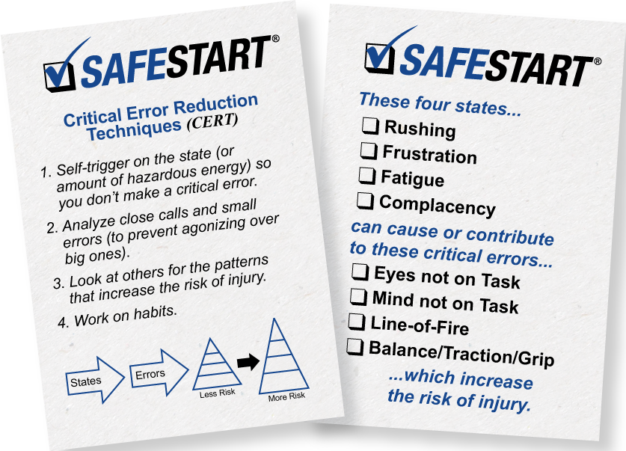

COVID-19
STAY INFORMED AND FOLLOW THE LATEST ADVICE GIVEN BY THE GOVERNMENT.
WE WILL GET THROUGH THIS TOGETHER.
http://uk.safestart.com | contact@ssi.safestart.com
Copyright © 2020 by SafeStart. All rights reserved. SafeStart is a registered trademark of Electrolab Limited.

